Slide 1
UCSD Embedded RTOS Assignment 2
By
Hsuankai Chang
hsuankac@umich.edu

Slide 2
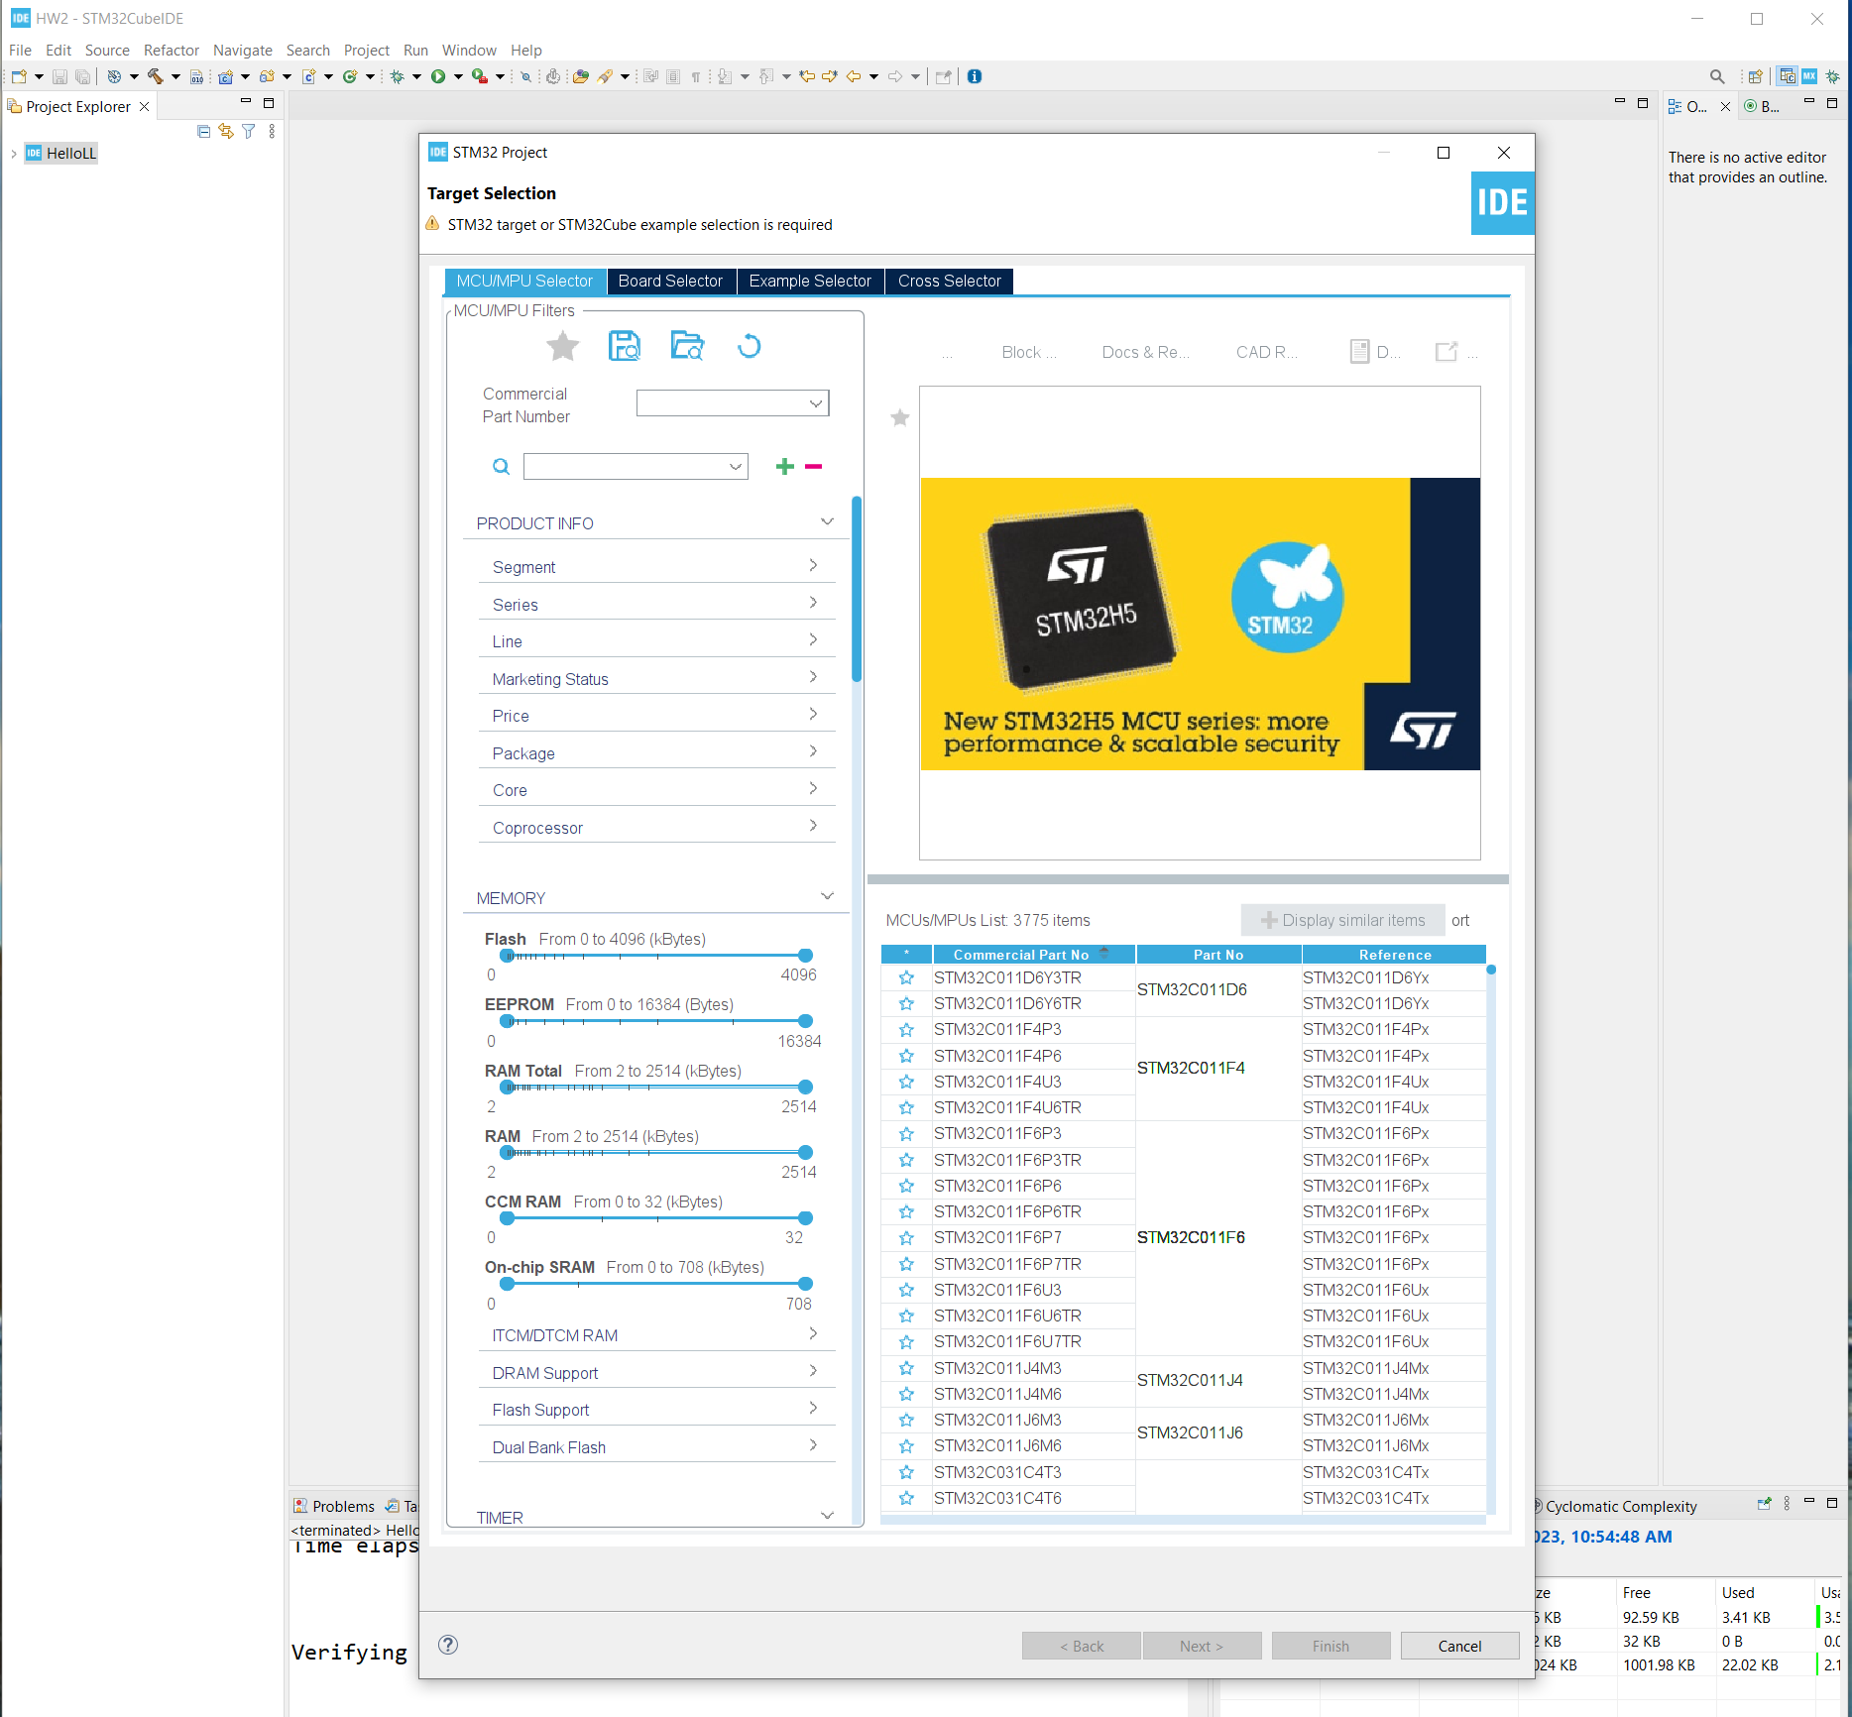
Step 1. Startup STM32CubeIDE and create new STM32 project

Slide 3
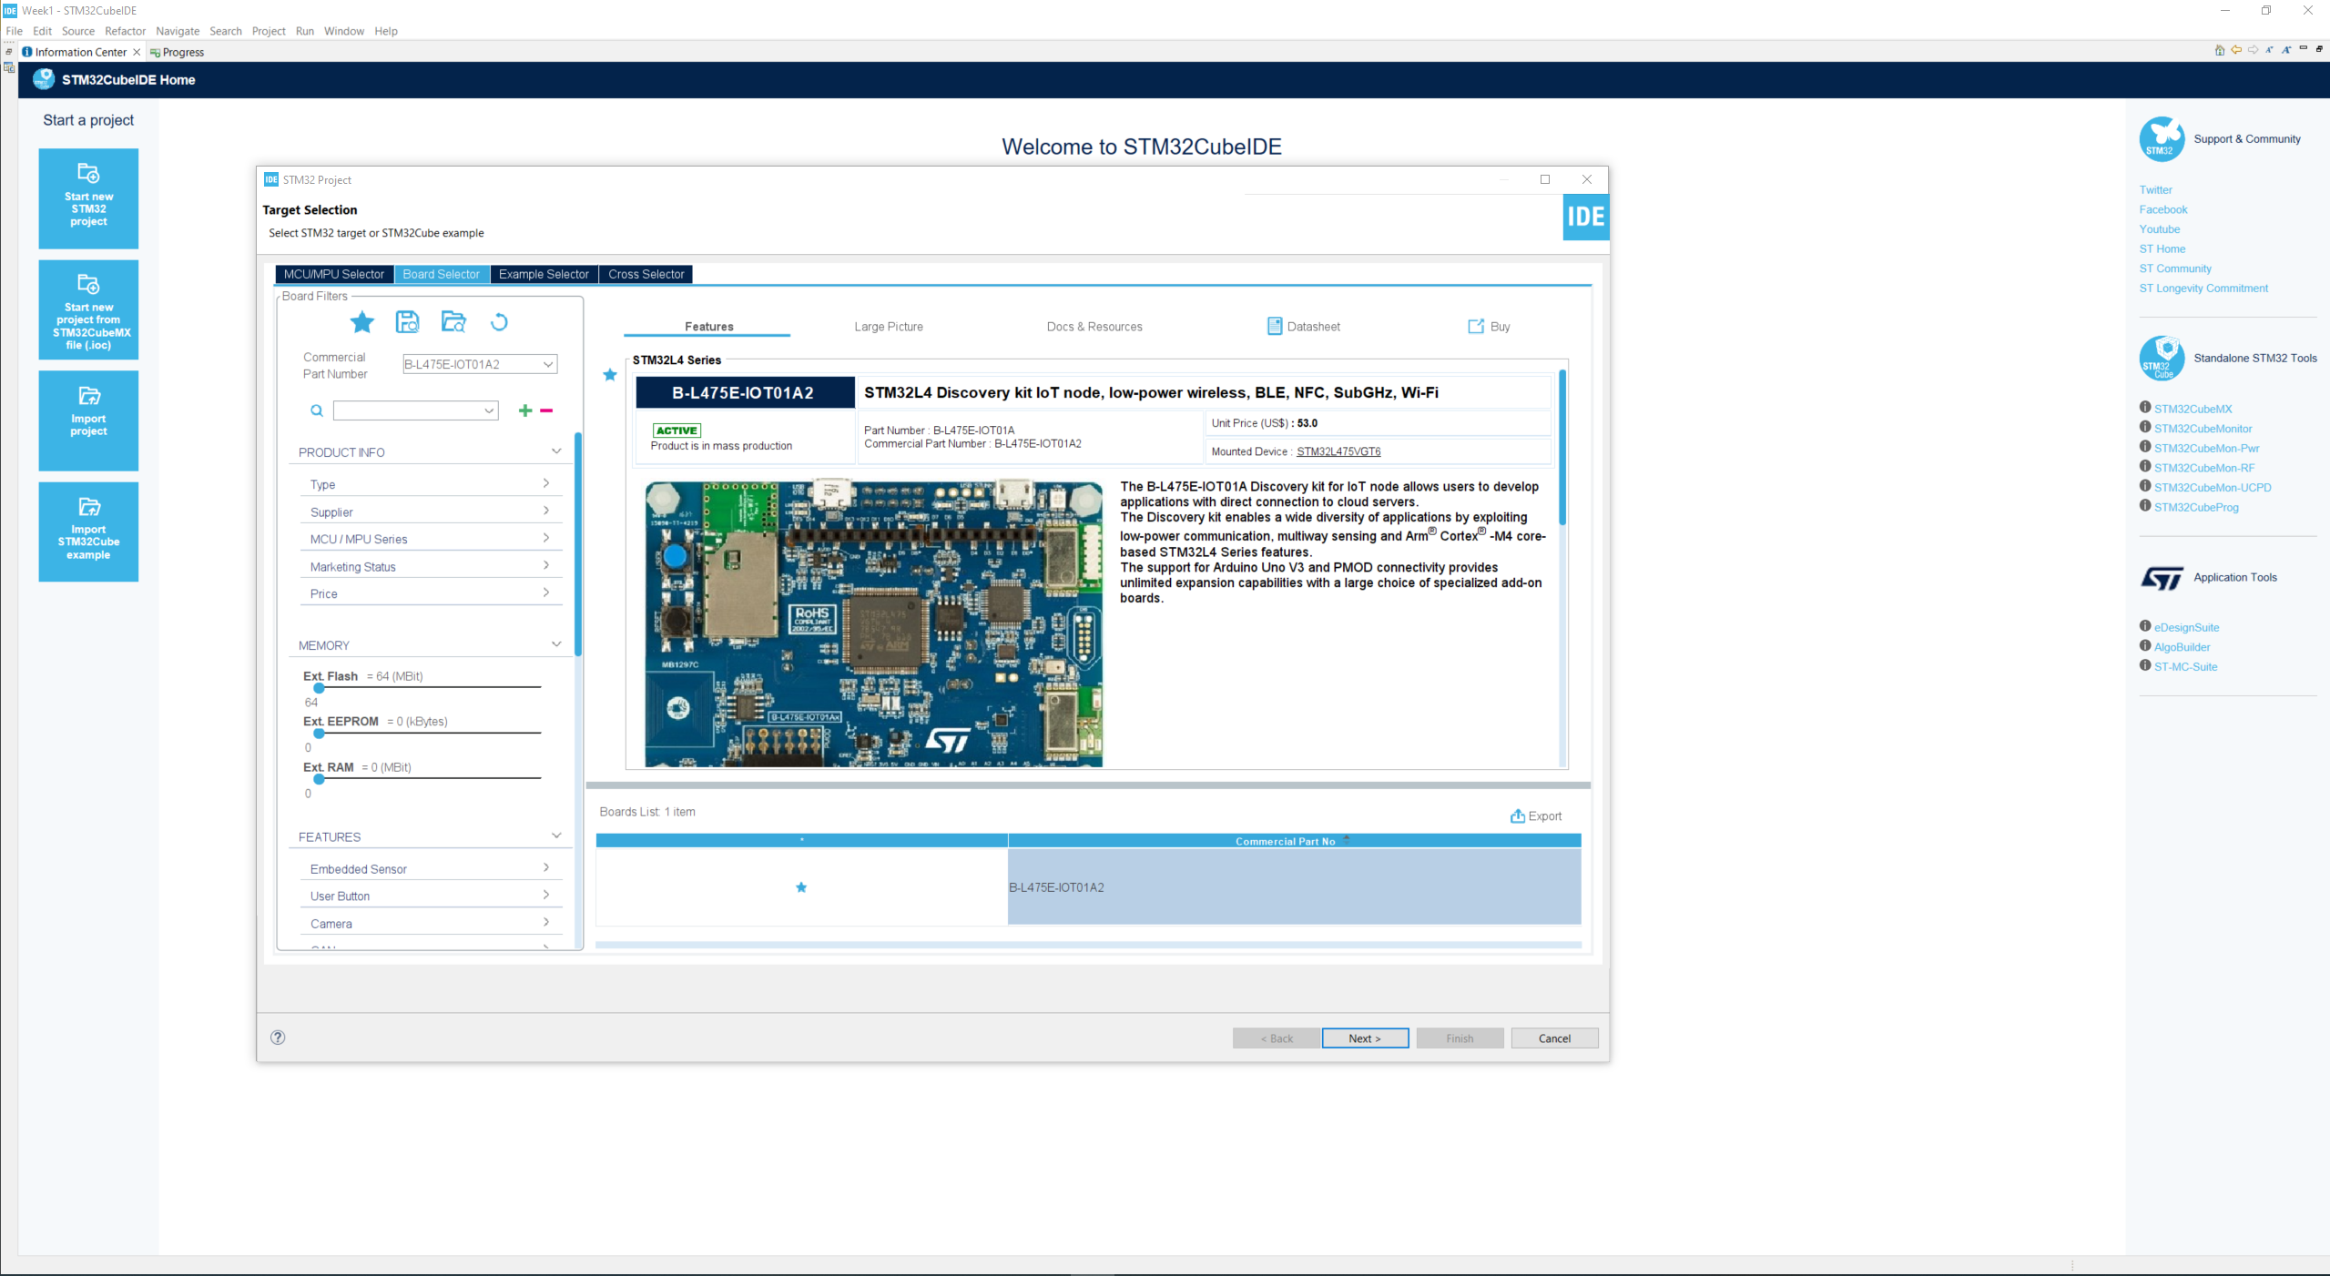
Step 2. Access board selector and type in the board you use, click Next

Slide 4
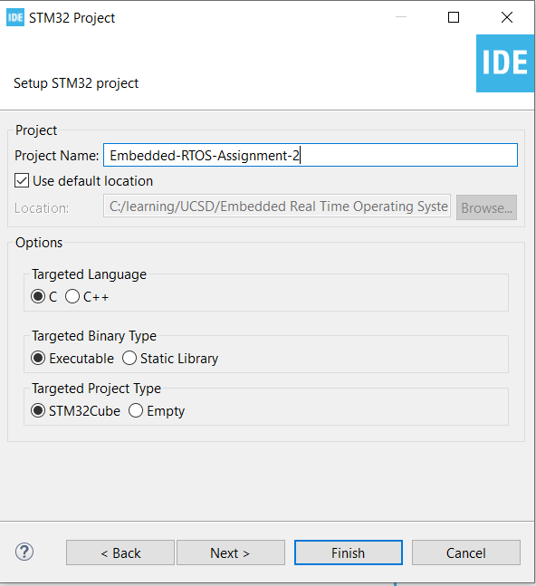
Step 3. Enter the project name then click Next

Slide 5
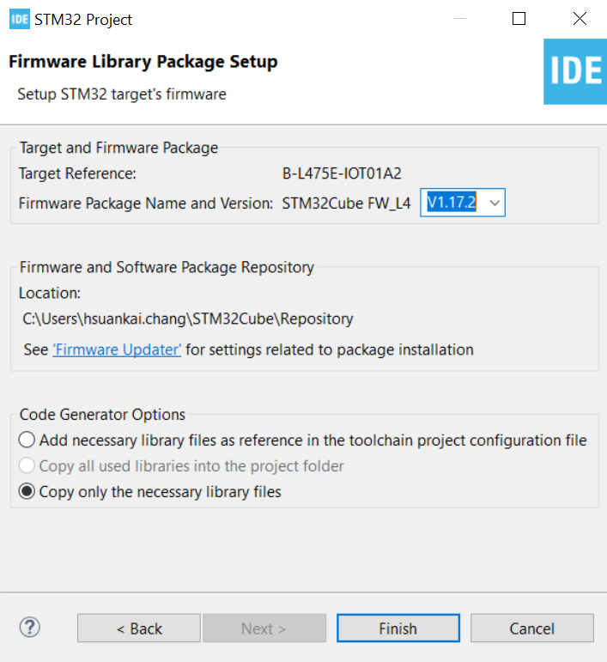
Step 4. See the firmware package name and version

Slide 6
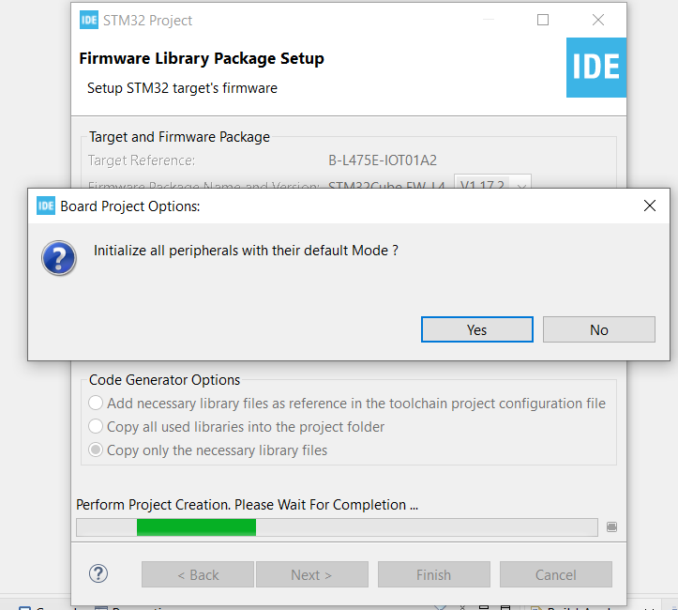
Step 5. Click yes to initialize all peripherals to default

Slide 7
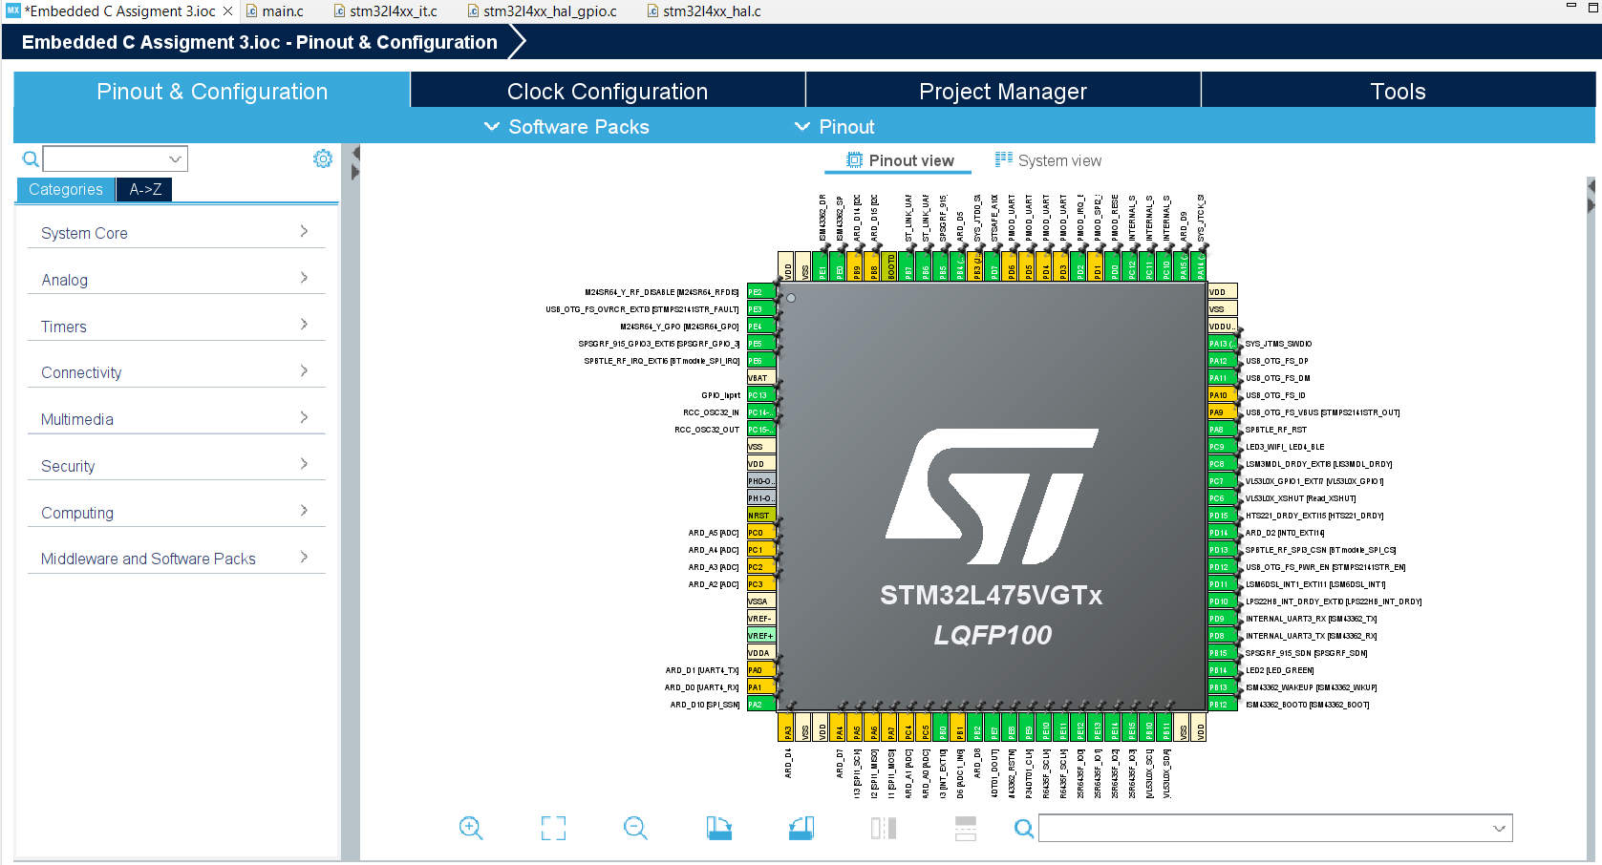
Step 6. When in .ioc file, click Pinout & Configurations

Slide 8
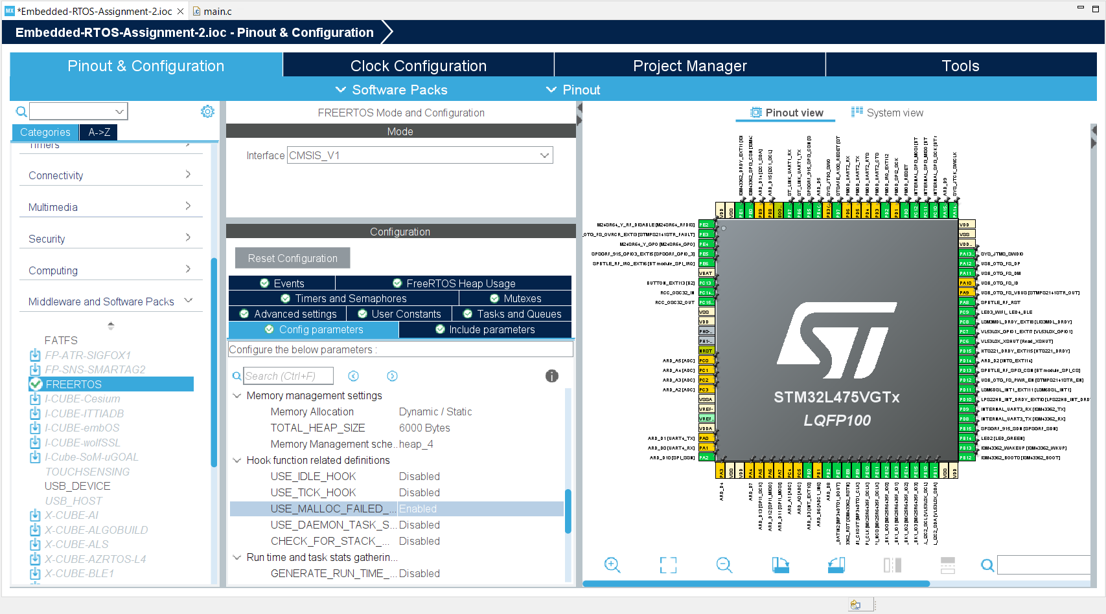
Step 7. Enable the FreeRTOS in middleware. Configure FreeRTOS for a HEAP memory size of 6000. Keep the default dynamic/static allocation along with the default memory 4 allocation option. Enable the malloc failed hook macro.

Slide 9
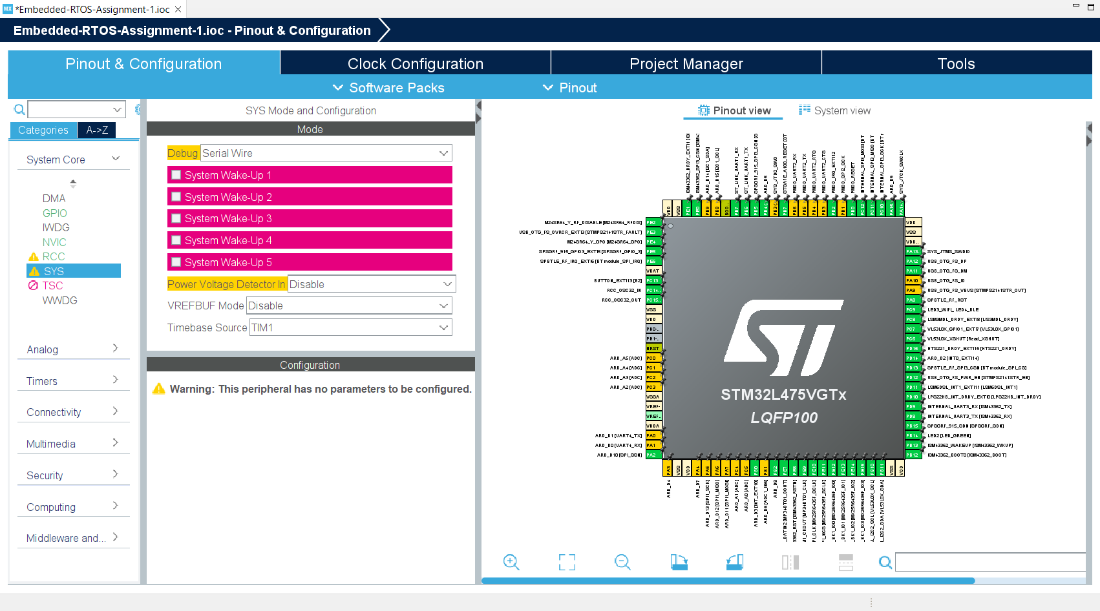
Step 8. Change Timebase from systick to TIM1

Slide 10
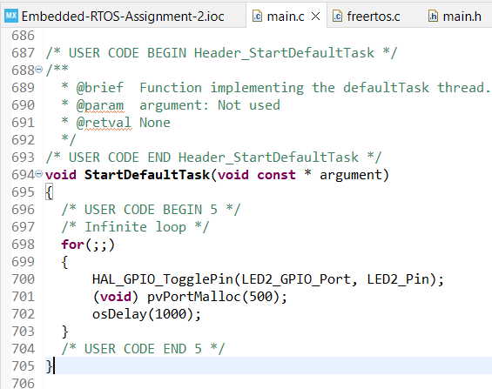
Step 9. In your default task, blink the LED2 every second and also use pvPortMalloc() to allocate 500 bytes every time you blink the LED2.

Slide 11
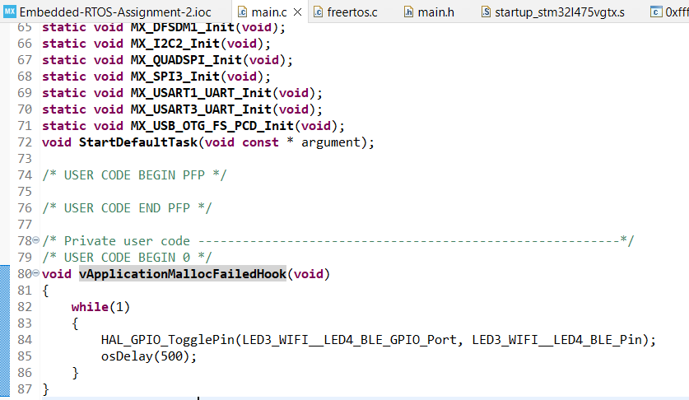
Step 10. Add the vApplicationMallocFailedHook() to your code so that when you run out of memory (remember you have a memory leak from in the default task as described in the previous bullet). The code in the vApplication MallocFailedHook() should be a "while (1) { }" that blinks the Wifi/BlE LEDs at a 0.5 second (1/2 second) rate.

Slide 12
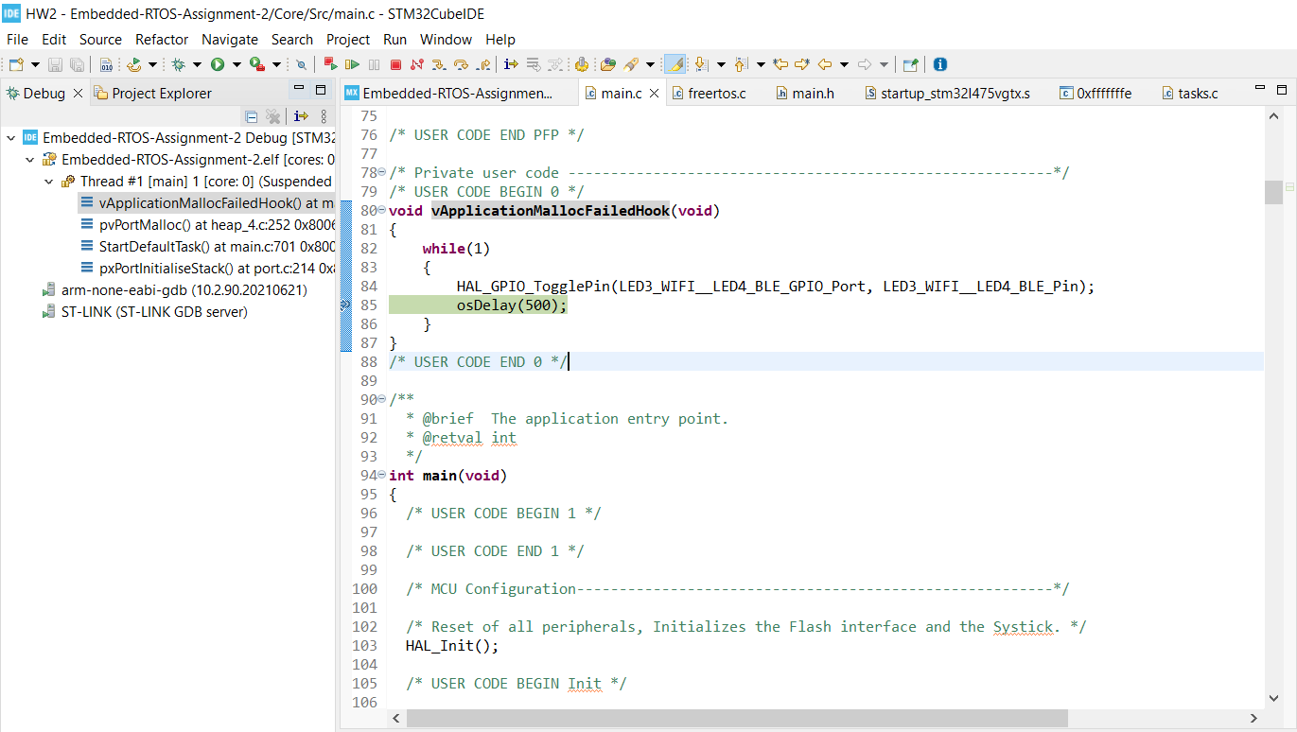
Step 11. Build and run the code, since after several loops, memory leaks occur, so the process will stuck in vApplicationMallocFailedHook and keep blinking WIFI/BLE LED rather than blinking LED2.

